Slide 1
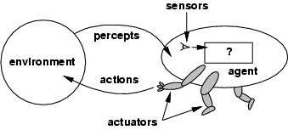
Agent
An agent is anything that can be viewed as perceiving its environment through sensors and acting upon that environment through actuators
We can view any AI program as an agent.

Slide 2
























Slide 3






Slide 4

























Slide 5





















































Slide 6





































Slide 7
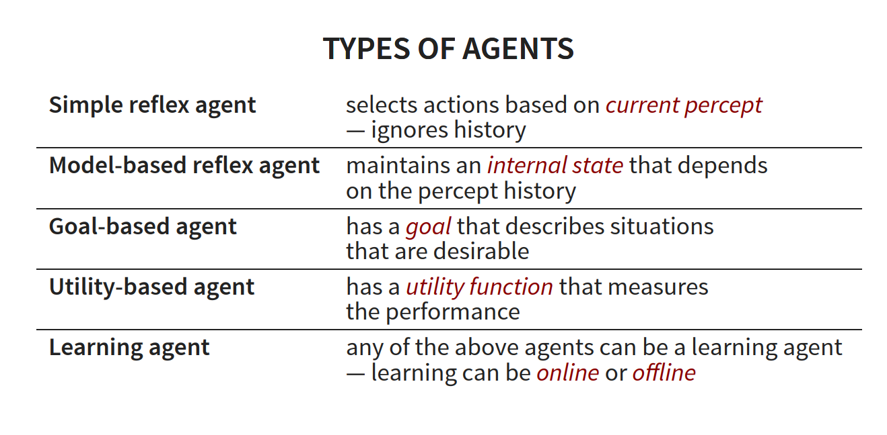

Slide 8



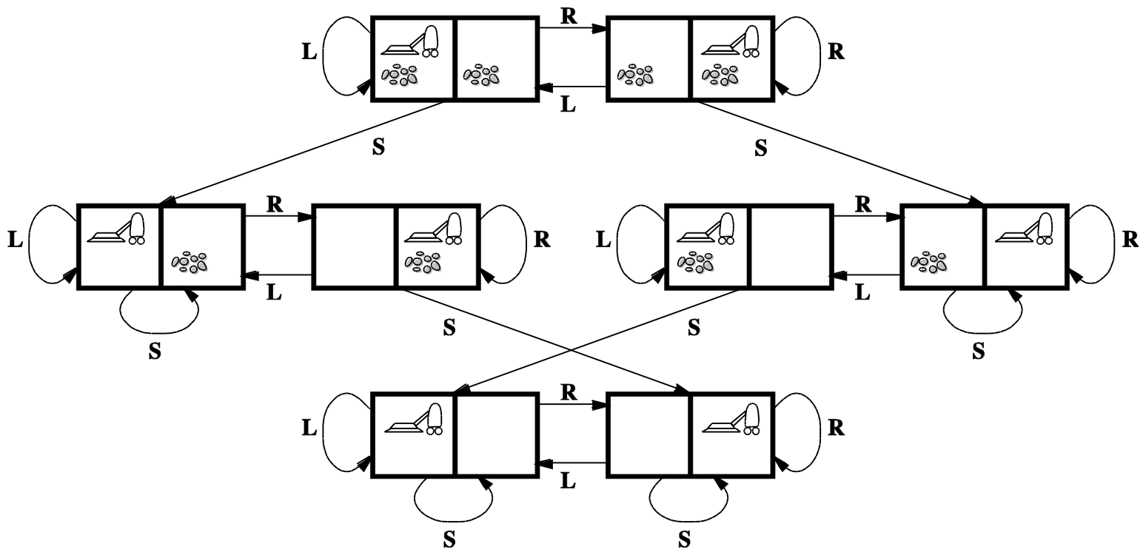
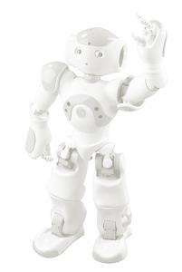

Slide 9
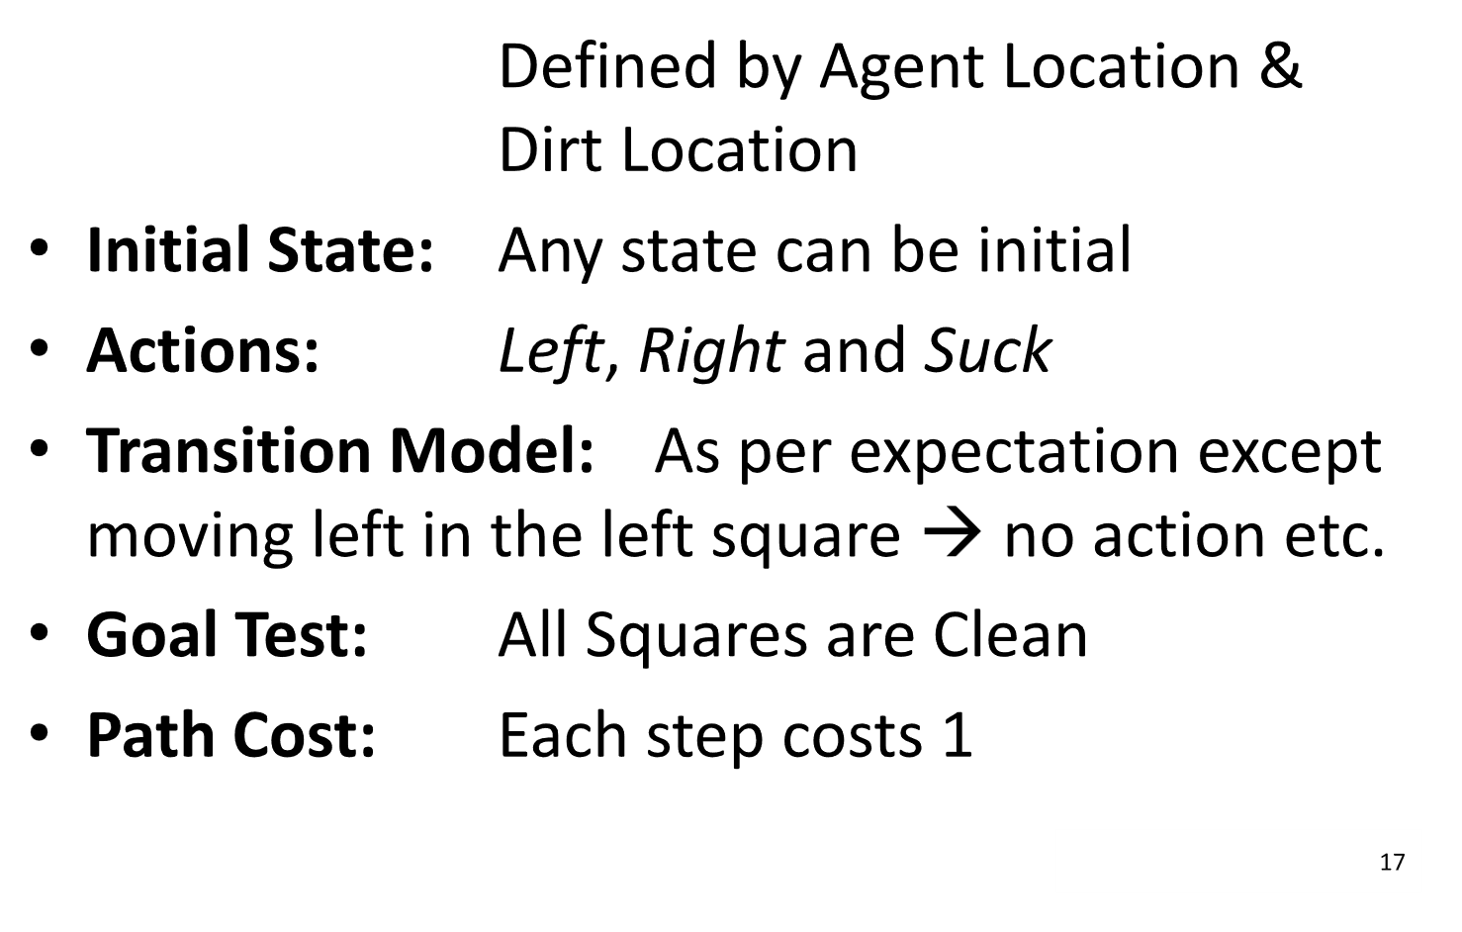


Slide 10

























Slide 11

















Slide 12














































Slide 13
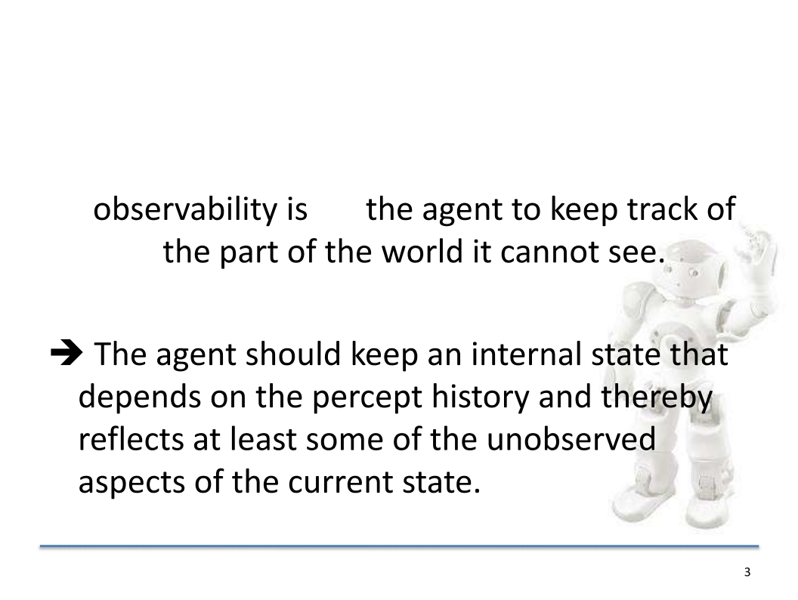



Slide 14
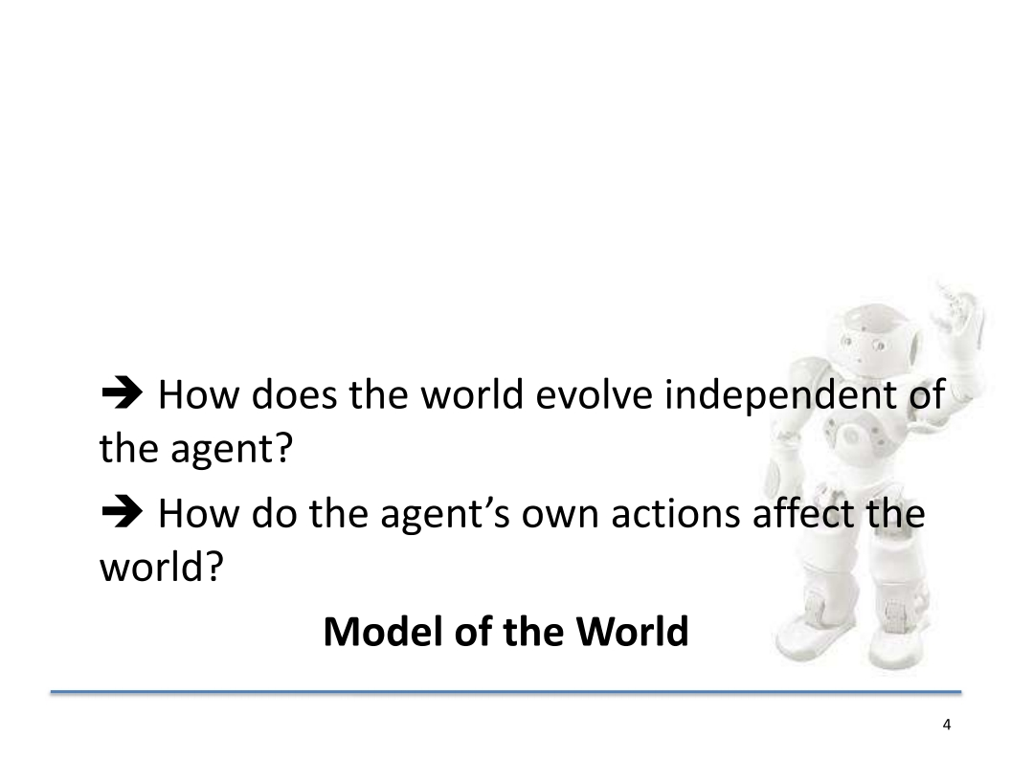



Slide 15
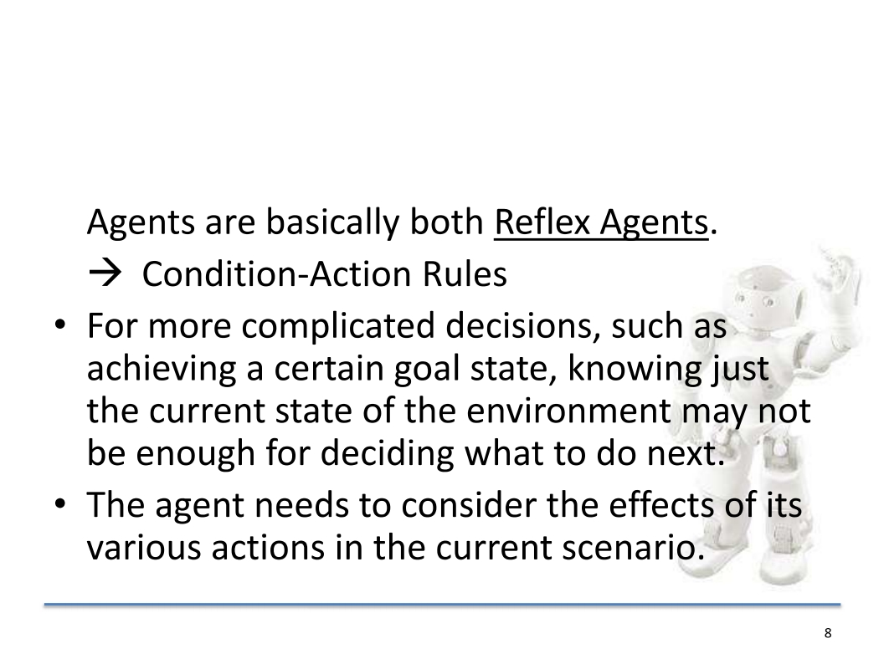



Slide 16
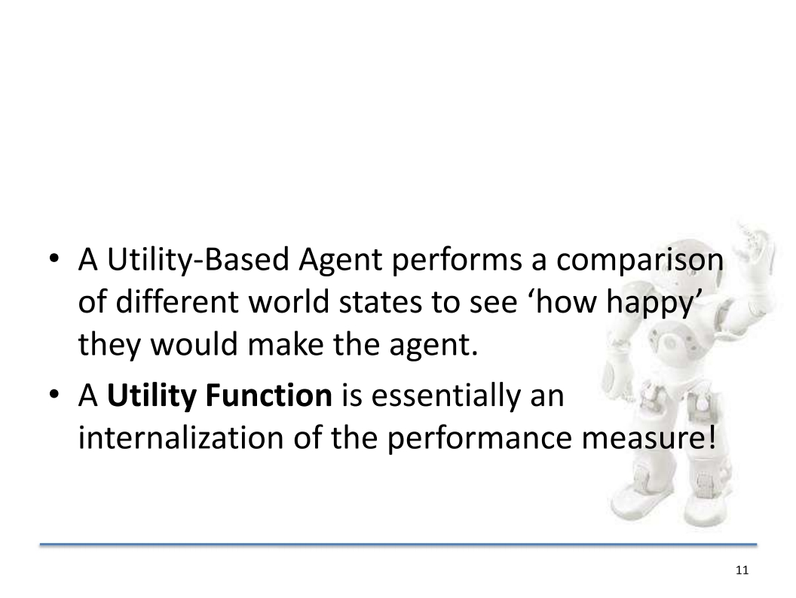



Slide 17
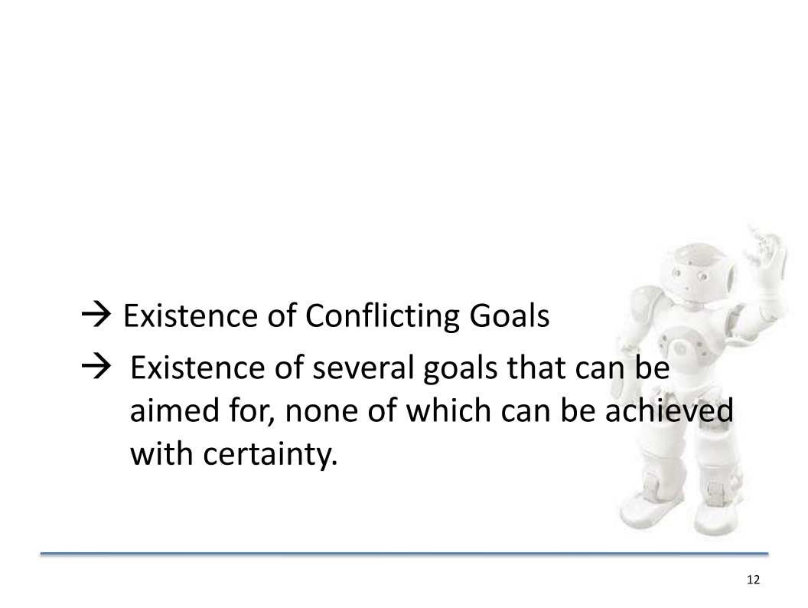


Slide 18
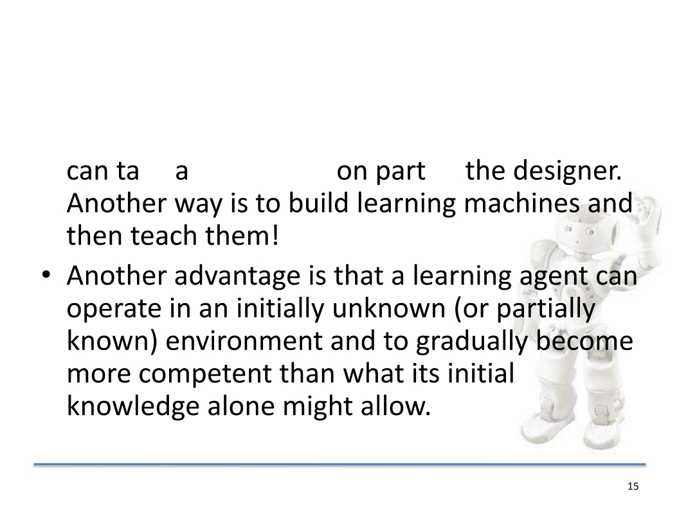


Slide 19
